Slide 1
Supervision from a Contextual Lens: SHAPE in Action
Linda Nicholson, PhD
&
Eric Morris, PhD

Slide 2
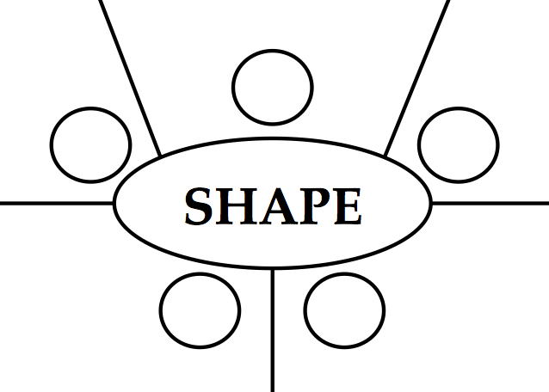
Poll

Slide 3
Objectives
At the end of the workshop participants will be able to:
describe a contextual supervision framework that promotes flexibility and functional perspectives.
identify and explore SHAPE processes via the use of experiential exercises and demonstrations.
to practise experientially responding to supervision scenarios involving contracting, functional analysis, and perspective-taking.

Slide 4
Contextual Supervision: increasing experiential learning

Slide 5
Shaping Competent ACT Therapists
In supervision we are interested in shaping therapists to:
be broadly adherent with the ACT model,
be increasing competent in strengthening psychological flexible responding

Slide 7
Why SHAPE?
The idea behind SHAPE is simple: it describes several features of effective ACT/CBS supervision
The SHAPE tool can be used as a way of prompting these choices and actions during supervision
And to reflect on these features between supervision sessions

Slide 8
SHAPE in Action
SHAPE can enhance supervision from a CBS perspective
SHAPE provides a way of engaging practitioners in supervision
SHAPE encourages supervisor & supervisee development of
psychological flexibility & sensitivity
mindfulness in therapy / supervision
skills in application of ACT and behaviour analysis.

Slide 9
lklkjlkj
Supervision Values
Hold Stories Lightly
Analysis of Function
SHAPE
Perspective Taking
Experiential Methods

Slide 10
lklkjlkj
Supervision Values
Hold Stories Lightly
Analysis of Function
Clarify the goals of supervision and connect with a valued direction (through and beyond these goals)
Use supervision contracting to promote commitment
Check in with valued actions and goals regularly in supervision sessions
Seek feedback in various ways
Connect – attend to the supervisory relationship
Promote supervisee learning from experience, rather than rules.
Attend to workability (pragmatism)
Use observation (direct, video/audio)
Foster curiosity in client actions in their contexts – ABCs, social environment, learning history
Review the impact of therapist behaviour on client in-session responses: functional analysis of therapy context
Attend to what influences supervision behaviours and choices: workable? values-based?
Notice story telling in supervision: promoting flexible responding?
SHAPE
Perspective Taking
Experiential Methods
Promote flexible perspective taking.
Notice variation of experience, perspectives
experience across a variety of contexts
contact with a range of experiences and changes
taking different perspectives of the same experience
Building reflective ability - what is it like:
for me to be working with this client?
to experience life from the client’s eyes?
to take the supervisor’s perspective? Others?
When perspectives are fixed, rigid, incoherent, fractured… and, what choices and actions are possible? How workable are these?
Engage in a variety of ways to learn from experience and promote supervisee sensitivity to client-therapist context:
Show… rather than Tell:
Use roleplay, modelling, reviewing audio- and video-recordings, direct observation
Noticing effects of describing vs evaluating/ explaining
Use analogy and perspective-taking when the supervisee is stuck
Undermine rule-following to please supervisor by encouraging the supervisee to track supervision content to client behaviour, especially when things don’t work as imagined…

Slide 11
Your Direction as a Supervisor?

Slide 12
Values Exercise
What is important to you about supervision?
What are my values as a supervisor?
Who do I want to be in the eyes of my supervisee?

Slide 13
Break Out Activity #1

Slide 14
Q & A

Slide 15
Supervision Values
Clarify the goals of supervision and connect with a valued direction (through and beyond these goals)
Use supervision contracting to promote commitment
Check in with valued actions and goals regularly in supervision sessions
Seek feedback in various ways
Connect with the CBS community

Slide 16
Our Story Telling Skills
It is useful to recognise, that to have made it this far in our careers… we are skilled at “story telling”
Supervision can easily become another story telling enterprise, accidentally promoting inflexibility
We can do better than offering various rules for therapists to follow… aside from the Golden Rule: Always Be Functional

Slide 17
Holding Stories Lightly
Promote supervisee learning from experience, rather than rules.
Attend to workability (pragmatism)
Use observation (direct, video/audio)
Notice story telling in supervision: promoting psychological flexibility?
Use storytelling to your supervisee's advantage: to model being human and imperfect and still moving forward"

Slide 18
Perspective Taking
Promote flexible perspective taking.
Notice variation of experience, perspectives
experience across a variety of contexts
contact with a range of experiences and changes
taking different perspectives of the same experience
Building reflective ability - what is it like:
for me to be working with this client?
to experience life from the client’s eyes?
to take the supervisor’s perspective? Others?
When perspectives are fixed, rigid, incoherent, fractured… and, what choices and actions are possible? How workable are these?

Slide 19
Break Out Activity #2

Slide 20
Exercise: Perspectives
Triads – Supervisee, Supervisor, Observer roles
Supervisee: describe a clinical situation where you had strong emotion about a client and found this limited your effectiveness.
Supervisor: encourage supervisee to describe the situation (self as process stance), noticing bodily sensations, urges, feelings and thoughts. Notice any stories about the client.
Supervisor: now encourage the supervisee to shift perspective, noticing other occasions when they have had this emotion.
This may include situations outside of clinical work, if the supervisee is willing.
Supervisor: bring in your “Self as Process” perspective – sharing what YOU notice showing up with this description, including any curiosity you have about the client and their behaviour. Embody your values as a supervisor in this interaction.

Slide 21
Reflection

Slide 22
Supervision isn't (necessarily) about resolution
While technical discussions happen, usually ACT supervision is about strengthening the supervisees ability to be psychologically flexible
The "supervision question" (especially with experienced supervisees) is usually the embarking point for a journey – exploring territory together, rather than providing a map
Struggling does not mean one can't be effective at the same time

Slide 23
Feedback & Discussion

